Slide 1

UNIT I
Data Warehousing, Business Analysis and On-Line Analytical Processing (OLAP)
by
A. Phani Sridhar
Assoc.Professor
Dept of Computer Science and Engineering
Aditya Engineering College(A)
Surampalem.

Slide 2

Contents:
Basic Concepts,
Data Warehousing Components,
Building a Data Warehouse,
Database Architectures for Parallel Processing,
Parallel DBMS Vendors,
Multidimensional Data Model,
Data Warehouse Schemas for Decision Support,
Concept Hierarchies,
Characteristics of OLAP Systems,
Typical OLAP Operations,
OLAP and OLTP.
Data Warehousing and Data Mining A. Phani Sridhar

Slide 3
Basic Concepts:
Data Warehouse:
1.A data warehouse refers to a data repository that is maintained separately from an organization's operational databases.
2. Data warehouse systems allow for integration of a variety of application systems.
3. They support information processing by providing a solid platform of consolidated historic data for analysis
Data Warehousing and Data Mining A. Phani Sridhar

Slide 4
Basic Concepts:
According to William H. Inmon, a leading architect in the construction of data warehouse systems.
“A data warehouse is a subject-oriented, integrated, time-variant, and nonvolatile collection of data in support of management’s decision making process”.
NOTE:The four keywords—subject-oriented, integrated, time-variant, and nonvolatile—distinguish data warehouses from other data repository systems, such as relational database systems, transaction processing systems, and file systems
Data Warehousing and Data Mining A. Phani Sridhar

Slide 5
Basic Concepts:
Subject-oriented: A data warehouse is organized around major subjects such as customers, supplier, product, and sales.
A data warehouse focuses on the modeling and analysis of data for decision makers. Hence, data warehouses typically provide a simple and concise view of particular subject issues by excluding data that are not useful in the decision support process.
Integrated: A data warehouse is usually constructed by integrating multiple heterogeneous sources, such as relational databases, flat files, and online transaction records. Data cleaning and data integration techniques are applied to ensure consistency in naming conventions, encoding structures, attribute measures, and so on.
Data Warehousing and Data Mining A. Phani Sridhar

Slide 6
Basic Concepts:
Time-variant: Data are stored to provide information from an historic perspective (e.g., the past 5–10 years). Every key structure in the data warehouse contains, either implicitly or explicitly, a time element.
NOTE: To discover trends in business
Nonvolatile: A data warehouse is always a physically separate store of data transformed from the application data found in the operational environment. Due to this separation, a data warehouse does not require transaction processing, recovery, and concurrency control mechanisms. It usually requires only two operations in data accessing: initial loading of data and access of data.
NOTE:− Non-volatile means the previous data is not erased when new data is added to it.
Data Warehousing and Data Mining A. Phani Sridhar

Slide 7
Basic Concepts:
Time-variant: Data are stored to provide information from an historic perspective (e.g., the past 5–10 years). Every key structure in the data warehouse contains, either implicitly or explicitly, a time element.
NOTE: To discover trends in business
Nonvolatile: A data warehouse is always a physically separate store of data transformed from the application data found in the operational environment. Due to this separation, a data warehouse does not require transaction processing, recovery, and concurrency control mechanisms. It usually requires only two operations in data accessing: initial loading of data and access of data.
NOTE:− Non-volatile means the previous data is not erased when new data is added to it.
Data Warehousing and Data Mining A. Phani Sridhar

Slide 8
“How are organizations using the information from data warehouses?”
Many organizations use this information to support business decision-making activities, including
increasing customer focus, which includes the analysis of customer buying patterns (such as buying preference, buying time, budget cycles, and appetites for spending);
repositioning products and managing product portfolios by comparing the performance of sales by quarter, by year, and by geographic regions in order to fine-tune production strategies;
analyzing operations and looking for sources of profit; and
managing customer relationships, making environmental corrections, and managing the cost of corporate assets
Data Warehousing and Data Mining A. Phani Sridhar

Slide 9
“Differences between Operational Database Systems and Data Warehouses
The major task of online operational database systems is to perform online transaction and query processing. These systems are called online transaction processing (OLTP) systems.
They cover most of the day-to-day operations of an organization such as purchasing,
inventory,
manufacturing,
banking,
payroll,
registration,
and accounting
Data Warehousing and Data Mining A. Phani Sridhar

Slide 10
“Differences between Operational Database Systems and Data Warehouses
DW serve users or knowledge workers in the role of data analysis and decision making. Such systems can organize and present data in various formats in order to accommodate the diverse needs of different users. These systems are known as online analytical processing (OLAP) systems.
Users and system orientation: An OLTP system is customer-oriented and is used for transaction and query processing by clerks, clients, and information technology professionals. An OLAP system is market-oriented and is used for data analysis by knowledge workers, including managers, executives, and analysts.
Data contents: An OLTP system manages current data that, typically, are too detailed to be easily used for decision making. An OLAP system manages large amounts of historic data, provides facilities for summarization and aggregation, and stores and manages information at different levels of granularity.
Data Warehousing and Data Mining A. Phani Sridhar

Slide 11
“Differences between Operational Database Systems and Data Warehouses
Database design: An OLTP system usually adopts an entity-relationship (ER) data model and an application-oriented database design. An OLAP system typically adopts either a star or a snowflake model and a subject-oriented database design.
View: An OLTP system focuses mainly on the current data within an enterprise or department, without referring to historic data or data in different organizations.
. In contrast, an OLAP system often spans multiple versions of a database schema, due to the evolutionary process of an organization.
Access patterns: The access patterns of an OLTP system consist mainly of short, atomic transactions. Such a system requires concurrency control and recovery mechanisms'. However, accesses to OLAP systems are mostly read-only operations (because most data warehouses store historic rather than up-to-date information),
Data Warehousing and Data Mining A. Phani Sridhar

Slide 12
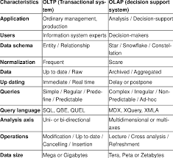
“Differences between Operational Database Systems and Data Warehouses
Data Warehousing and Data Mining A. Phani Sridhar

Slide 13
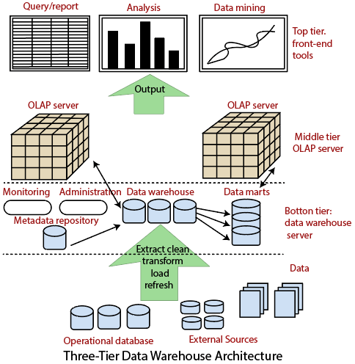
Data Warehousing: A Multitiered Architecture
Data Warehousing and Data Mining A. Phani Sridhar

Slide 14
Data Warehousing: A Multitiered Architecture
The bottom tier is a warehouse database server that is almost always a relational database system. Back-end tools and utilities are used to feed data into the bottom tier from operational databases or other external sources (e.g., customer profile information provided by external consultants).
These tools and utilities perform data extraction, cleaning, and transformation (e.g., to merge similar data from different sources into a unified format), as well as load and refresh functions to update the data warehouse.
The data are extracted using application program interfaces known as gateways. A gateway is supported by the underlying DBMS and allows client programs to generate SQL code to be executed at a server.
NOTE:This tier also contains a metadata repository, which stores information about the data warehouse and its contents
Data Warehousing and Data Mining A. Phani Sridhar

Slide 15
Data Warehousing: A Multitiered Architecture
The middle tier is an OLAP server that is typically implemented using either (1) a relational OLAP (ROLAP) model (i.e., an extended relational DBMS that maps operations on multidimensional data to standard relational operations); or (2) a multidimensional OLAP (MOLAP) model (i.e., a special-purpose server that directly implements multidimensional data and operations).
The top tier is a front-end client layer, which contains query and reporting tools, analysis tools, and/or data mining tools (e.g., trend analysis, prediction, and so on).
Data Warehousing and Data Mining A. Phani Sridhar

Slide 16
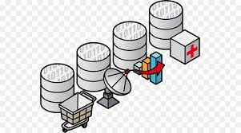
Data Warehouse Models: Enterprise Warehouse, Data Mart, and Virtual Warehouse
Enterprise warehouse: An enterprise warehouse collects all of the information about subjects spanning the entire organization. It provides corporate-wide data integration, usually from one or more operational systems or external information providers.
An enterprise data warehouse may be implemented on traditional mainframes, computer super servers, or parallel architecture platforms.
Data Mart: A data mart contains a subset of corporate-wide data that is of value to a specific group of users. The scope is confined to specific selected subjects.
Examples: data mart may confine its subjects to customer, item, and sales.
Data Warehousing and Data Mining A. Phani Sridhar

Slide 17
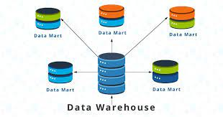
Data Warehouse Models: Enterprise Warehouse, Data Mart, and Virtual Warehouse
(or)
A Data Mart is focused on a single functional area of an organization and contains a subset of data stored in a Data Warehouse.
Depending on the source of data, data marts can be categorized as independent or dependent.
An independent data mart is a stand-alone system—created without the use of a data warehouse—that focuses on one subject area or business function.
Dependent data marts are sourced directly from enterprise data warehouses.
Data Warehousing and Data Mining A. Phani Sridhar

Slide 18
Data Warehouse Models: Enterprise Warehouse, Data Mart, and Virtual Warehouse
 | Data Mart | Data Warehouse
Size | < 100 GB | 100 GB +
Subject | Single Subject | Multiple Subjects
Scope | Line-of-Business | Enterprise-wide
Data Sources | Few Sources | Many Source Systems
Data Integration | One Subject Area | All Business Data
Time to Build | Minutes, Weeks, Months | Many Months to Years
.
Data Warehousing and Data Mining A. Phani Sridhar

Slide 19
Data Warehouse Models: Enterprise Warehouse, Data Mart, and Virtual Warehouse
Virtual warehouse: A virtual warehouse is a set of views over operational databases. For efficient query processing, only some of the possible summary views may be materialized. A virtual warehouse is easy to build but requires excess capacity on operational database servers.
Data Warehousing and Data Mining A. Phani Sridhar

Slide 20
Extraction, Transformation, and Loading:Data warehouse systems use back-end tools and utilities to populate and refresh their data
Data extraction, which typically gathers data from multiple, heterogeneous, and external sources.
Data cleaning, which detects errors in the data and rectifies them when possible.
Data transformation, which converts data from legacy or host format to warehouse format.
Load, which sorts, summarizes, consolidates, computes views, checks integrity, and builds indices and partitions.
Refresh, which propagates the updates from the data sources to the warehouse.
Data Warehousing and Data Mining A. Phani Sridhar

Slide 21
Metadata Repository
Metadata are data about data. When used in a data warehouse, metadata are the data that define warehouse objects.
Additional metadata are created and captured for timestamping any extracted data, the source of the extracted data, and missing fields that have been added by data cleaning or integration processes.
Contents:
A description of the data warehouse structure, which includes the warehouse schema, view, dimensions, hierarchies, and derived data definitions, as well as data mart locations and contents.
Operational metadata, which include data lineage (history of migrated data and the sequence of transformations applied to it), currency of data (active, archived, or purged), and monitoring information (warehouse usage statistics, error reports, and audit trails).
Data Warehousing and Data Mining A. Phani Sridhar

Slide 22
Metadata Repository
Metadata are data about data. When used in a data warehouse, metadata are the data that define warehouse objects.
Additional metadata are created and captured for timestamping any extracted data, the source of the extracted data, and missing fields that have been added by data cleaning or integration processes.
Contents:
A description of the data warehouse structure, which includes the warehouse schema, view, dimensions, hierarchies, and derived data definitions, as well as data mart locations and contents.
Operational metadata, which include data lineage (history of migrated data and the sequence of transformations applied to it), currency of data (active, archived, or purged), and monitoring information (warehouse usage statistics, error reports, and audit trails).
Data Warehousing and Data Mining A. Phani Sridhar

Slide 23
Metadata Repository
  3. The algorithms used for summarization, which include measure and dimension definition algorithms, data on granularity, partitions, subject areas, aggregation, summarization, and predefined queries and reports.
  4. Data related to system performance, which include indices and profiles that improve data access and retrieval performance, in addition to rules for the timing and scheduling of refresh, update, and replication cycles.
  5.Business metadata, which include business terms and definitions, data ownership information, and charging policies.
Data Warehousing and Data Mining A. Phani Sridhar

Slide 24
Data Warehouse Modeling: Data Cube and OLAP
  Data warehouses and OLAP tools are based on a multidimensional data model. This model views data in the form of a data cube.
  A data cube allows data to be modeled and viewed in multiple dimensions. It is defined by dimensions and facts
  Dimensions are the perspectives or entities with respect to which an organization wants to keep records.
  For example, All Electronics may create a sales data warehouse in order to keep records of the store’s sales with respect to the dimensions time, item, branch, and location.
  A multidimensional data model is typically organized around a central theme, such as sales. This theme is represented by a fact table. Facts are numeric measures. Think of them as the quantities by which we want to analyze relationships between dimensions
Data Warehousing and Data Mining A. Phani Sridhar

Slide 25
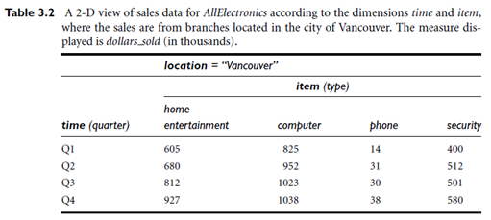
Data Warehouse Modeling: Data Cube and OLAP
Example:2D View of sales data
Data Warehousing and Data Mining A. Phani Sridhar

Slide 26
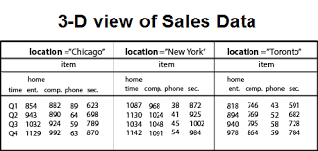
Data Warehouse Modeling: Data Cube and OLAP
Example:3D View of sales data
Data Warehousing and Data Mining A. Phani Sridhar

Slide 27
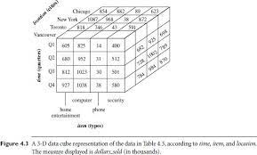
Data Warehouse Modeling: Data Cube and OLAP
Example:3D View of sales data cube
Data Warehousing and Data Mining A. Phani Sridhar

Slide 28
Lattice of cuboids, making up a 4-D data cube for time, item, location, and supplier. Each cuboid represents a different degree of summarization.
Given a set of dimensions, we can generate a cuboid for each of the possible subsets of the given dimensions. The result would form a lattice of cuboids, each showing the data at a different level of summarization, or group-by. The lattice of cuboids is then referred to as a data cube.
Lattice of cuboids forming a data cube for the dimensions time, item, location, and supplier.
Data Warehousing and Data Mining A. Phani Sridhar

Slide 29
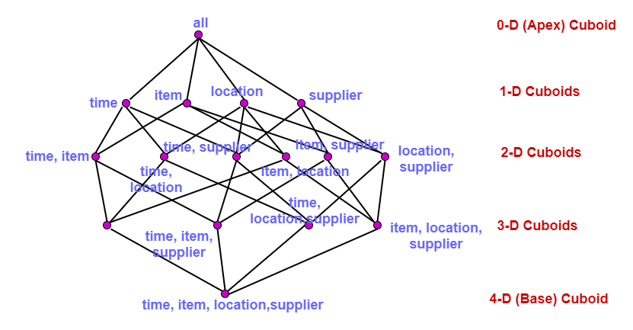
Lattice of cuboids, making up a 4-D data cube for time, item, location, and supplier. Each cuboid represents a different degree of summarization.
Data Warehousing and Data Mining A. Phani Sridhar

Slide 30
Lattice of cuboids, making up a 4-D data cube for time, item, location, and supplier. Each cuboid represents a different degree of summarization.
The cuboid that holds the lowest level of summarization is called the base cuboid.
The 0-D cuboid, which holds the highest level of summarization, is called the apex cuboid.
The apex cuboid, or 0-D cuboid, refers to the case where the group-by is empty. It contains the total sum of all sales. The apex cuboid is the most generalized (least specific) of the cuboids, and is often denoted as all.
The base cuboid is the least generalized (most specific) of the cuboids.
Data Warehousing and Data Mining A. Phani Sridhar

Slide 31
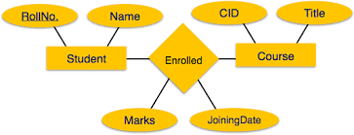
Stars, Snowflakes, and Fact Constellations: Schemas for
Multidimensional Data Models.
The entity-relationship data model is commonly used in the design of relational databases, where a database schema consists of a set of entities and the relationships between them
Data Warehousing and Data Mining A. Phani Sridhar

Slide 32
Stars, Snowflakes, and Fact Constellations: Schemas for
Multidimensional Data Models.
The most popular data model for a data warehouse is a multidimensional model,which can exist in the form of a star schema, a snowflake schema, or a fact constellation schema.
Star Scheme:
The most common modeling paradigm is the star schema, in which the data warehouse contains (1) a large central table (fact table) containing the bulk of the data, with no redundancy, and
(2) a set of smaller attendant tables (dimension tables), one for each dimension.
The schema graph resembles a starburst, with the dimension tables displayed in a radial pattern around the central fact table.
Data Warehousing and Data Mining A. Phani Sridhar

Slide 33
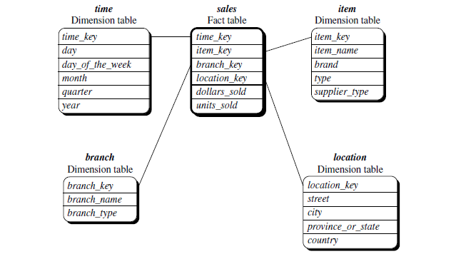
Stars, Snowflakes, and Fact Constellations: Schemas for
Multidimensional Data Models.
Star Scheme: Sales are considered along four dimensions: time, item, branch, and location. The schema contains a central fact table for sales that contains keys to each of the four dimensions, along with two measures: dollars sold and units sold. To minimize the size of the fact table, dimension identifiers (e.g., time key and item key) are system-generated identifiers.
Data Warehousing and Data Mining A. Phani Sridhar

Slide 34
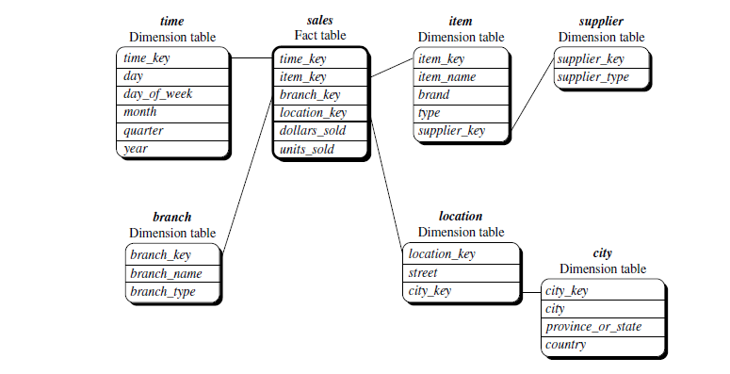
Stars, Snowflakes, and Fact Constellations: Schemas for
Multidimensional Data Models.
Snowflake schema: The snowflake schema is a variant of the star schema model, where some dimension tables are normalized, thereby further splitting the data into additional tables.
The resulting schema graph forms a shape similar to a snowflake..
Data Warehousing and Data Mining A. Phani Sridhar

Slide 35
Stars, Snowflakes, and Fact Constellations: Schemas for
Multidimensional Data Models.
Snowflake schema: The snowflake schema is a variant of the star schema model,
The major difference between the snowflake and star schema models is that the dimension tables of the snowflake model may be kept in normalized form to reduce redundancies. Such a table is easy to maintain and saves storage space.
The snowflake structure can reduce the effectiveness of browsing, since more joins will be needed to execute a query.
The single dimension table for item in the star schema is normalized in the snowflake schema, resulting in new item and supplier tables. For example, the item dimension table now contains the attributes item key, item name, brand, type, and supplier key, where supplier key is linked to the supplier dimension table, containing supplier key and supplier type information
Data Warehousing and Data Mining A. Phani Sridhar

Slide 36
Stars, Snowflakes, and Fact Constellations: Schemas for
Multidimensional Data Models.
Snowflake schema: The snowflake schema is a variant of the star schema model,
Similarly, the single dimension table for location in the star schema can be normalized into two new tables: location and city. The city key in the new location table links to the city dimension.
Data Warehousing and Data Mining A. Phani Sridhar

Slide 37
Stars, Snowflakes, and Fact Constellations: Schemas for
Multidimensional Data Models.
Fact constellation: Sophisticated applications may require multiple fact tables to share dimension tables. This kind of schema can be viewed as a collection of stars, and hence is called. a galaxy schema or a fact constellation.
This schema specifies two fact tables, sales and shipping. The sales table definition is identical to that of the star schema .
The shipping table has five dimensions, or keys—item key, time key, shipper key, from location, and to location—and two measures—dollars cost and units shipped.
A fact constellation schema allows dimension tables to be shared between fact tables. For example, the dimensions tables for time, item, and location are shared between the sales and shipping fact tables.
Data Warehousing and Data Mining A. Phani Sridhar

Slide 38
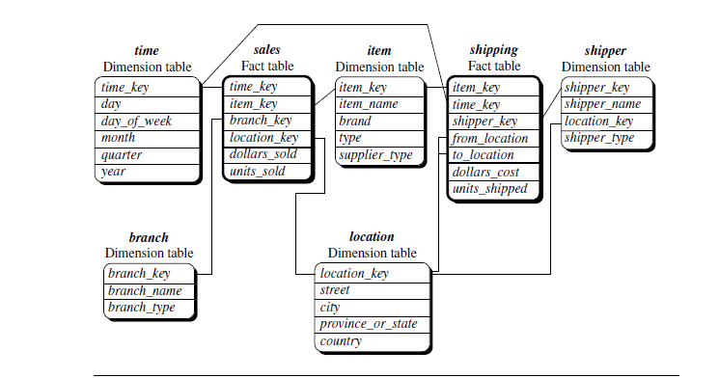
Stars, Snowflakes, and Fact Constellations: Schemas for
Multidimensional Data Models.
Data Warehousing and Data Mining A. Phani Sridhar

Slide 39
Stars, Snowflakes, and Fact Constellations: Schemas for
Multidimensional Data Models.
For data warehouses, the fact constellation schema is commonly used, since it can model multiple, interrelated subjects.
A data mart, on the other hand, is a department subset of the data warehouse that focuses on selected subjects, and thus its scope is department wide. For data marts, the star or snowflake schema is commonly used, since both are geared toward modeling single subjects
Data Warehousing and Data Mining A. Phani Sridhar

Slide 40
Dimensions: The Role of Concept Hierarchies
A concept hierarchy defines a sequence of mappings from a set of low-level concepts to higher-level, more general concepts.
Example: Consider a concept hierarchy City values for location include Vancouver, Toronto, New York, and Chicago. Each city, however, can be mapped to the province or state to which it belongs. For example, Vancouver can be mapped to British Columbia, and Chicago to Illinois.
The provinces and states can in turn be mapped to the country (e.g., Canada or the United States) to which they belong for the dimension location.
Many concept hierarchies are implicit within the database schema. For example, suppose that the dimension location is described by the attributes number, street, city, province or state, zip code, and country. These attributes are related by a total order, forming a concept hierarchy such as “street < city < province or state < country.”
Data Warehousing and Data Mining A. Phani Sridhar

Slide 41
Dimensions: The Role of Concept Hierarchies
Alternatively, the attributes of a dimension may be organized in a partial order, forming a lattice. An example of a partial order for the time dimension based on the attributes day, week, month, quarter, and year is “day <month < quarter; week < year.”1 .This lattice structure is shown in Figure.
NOTE:A concept hierarchy that is a total or partial order among attributes in a database schema is called a schema hierarchy.
Concept hierarchies may also be defined by discretizing or grouping values for a given dimension or attribute, resulting in a set-grouping hierarchy. A total or partial order can be defined among groups of values.
Example:
The dimension price, where an interval [$X : : :$Y] denotes the range from $X (exclusive) to $Y (inclusive).
Data Warehousing and Data Mining A. Phani Sridhar

Slide 42
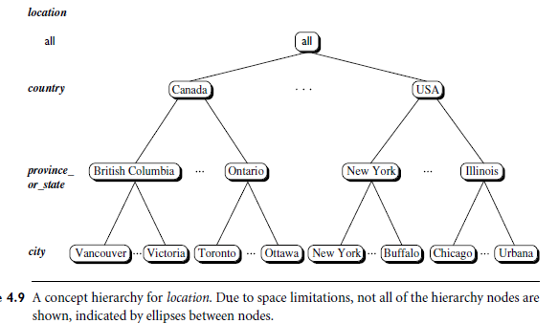
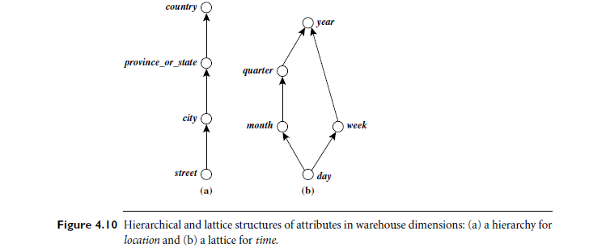
Dimensions: The Role of Concept Hierarchies
Data Warehousing and Data Mining A. Phani Sridhar

Slide 43
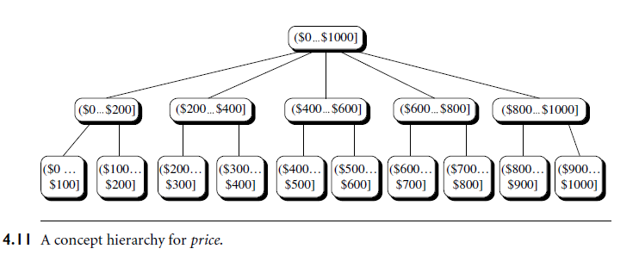
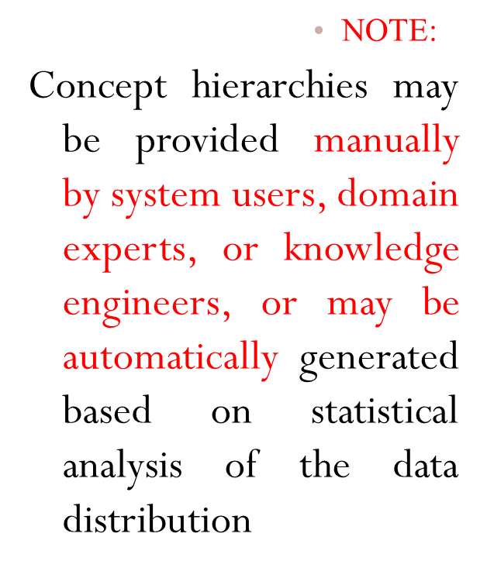
Dimensions: The Role of Concept Hierarchies
Data Warehousing and Data Mining A. Phani Sridhar

Slide 44
Dimensions: The Role of Concept Hierarchies
A concept hierarchy defines a sequence of mappings from a set of low-level concepts to higher-level, more general concepts.
Example: Consider a concept hierarchy City values for location include Vancouver, Toronto, New York, and Chicago. Each city, however, can be mapped to the province or state to which it belongs. For example, Vancouver can be mapped to British Columbia, and Chicago to Illinois.
The provinces and states can in turn be mapped to the country (e.g., Canada or the United States) to which they belong for the dimension location.
Many concept hierarchies are implicit within the database schema. For example, suppose that the dimension location is described by the attributes number, street, city, province or state, zip code, and country. These attributes are related by a total order, forming a concept hierarchy such as “street < city < province or state < country.”
Data Warehousing and Data Mining A. Phani Sridhar

Slide 45
OLAP Operations
Multidimensional Model provides users with the flexibility to view data from different perspectives. A number of OLAP data cube operations exist to materialize these different views, allowing interactive querying and analysis of the data at hand.
Example: The cube contains the dimensions location, time, and item, where location is aggregated with respect to city values, time is aggregated with respect to quarters, and item is aggregated with respect to item types.
Data Warehousing and Data Mining A. Phani Sridhar

Slide 46
OLAP Operations
1.Roll-up: The roll-up operation (also called the drill-up operation by some vendors) performs aggregation on a data cube, either by climbing up a concept hierarchy for a dimension or by dimension reduction.
Example: The roll-up operation shown aggregates the data by ascending the location hierarchy from the level of city to the level of country.
NOTE: When roll-up is performed by dimension reduction, one or more dimensions are removed from the given cube.
2. Drill-down: Drill-down is the reverse of roll-up. It navigates from less detailed data to more detailed data. Drill-down can be realized by either stepping down a concept hierarchy for a dimension or introducing additional dimensions.
Drill-down occurs by descending the time hierarchy from the level of quarter to the more detailed level of month. The resulting data cube details the total sales per month rather than summarizing them by quarter.
Data Warehousing and Data Mining A. Phani Sridhar

Slide 47
OLAP Operations
3. Slice and dice: The slice operation performs a selection on one dimension of the given cube, resulting in a subcube.
The dice operation defines a subcube by performing a selection on two or more dimensions
4.Pivot (rotate): Pivot (also called rotate) is a visualization operation that rotates the data axes in view to provide an alternative data presentation
Data Warehousing and Data Mining A. Phani Sridhar

Slide 48
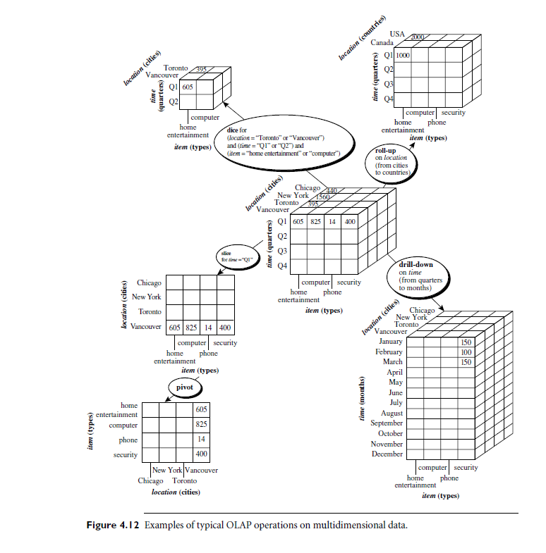
OLAP Operations
Data Warehousing and Data Mining A. Phani Sridhar

Slide 49
OtherOLAP Operations
Other OLAP operations: Some OLAP systems offer additional drilling operations. For example, drill-across executes queries involving (i.e., across) more than one fact table.
The drill-through operation uses relational SQL facilities to drill through the bottom level of a data cube down to its back-end relational tables.
Other OLAP operations may include ranking the top N or bottom N items in lists, as well as computing moving averages, growth rates, interests, internal return rates, depreciation, currency conversions, and statistical functions
Data Warehousing and Data Mining A. Phani Sridhar

